Slide 1

USAID/Ethiopia Virtual Implementing Partners Meeting
April 22, 2020

Slide 2

Today’s Agenda
3:30 Welcoming Remarks
3:40 USG International Assistance Strategy for COVID-19
3:50 How USAID is Pivoting
3:55 How USAID is Helping IPs
4:00 Monitoring Programs
4:10 Q&A
4:55 Closing

Slide 3
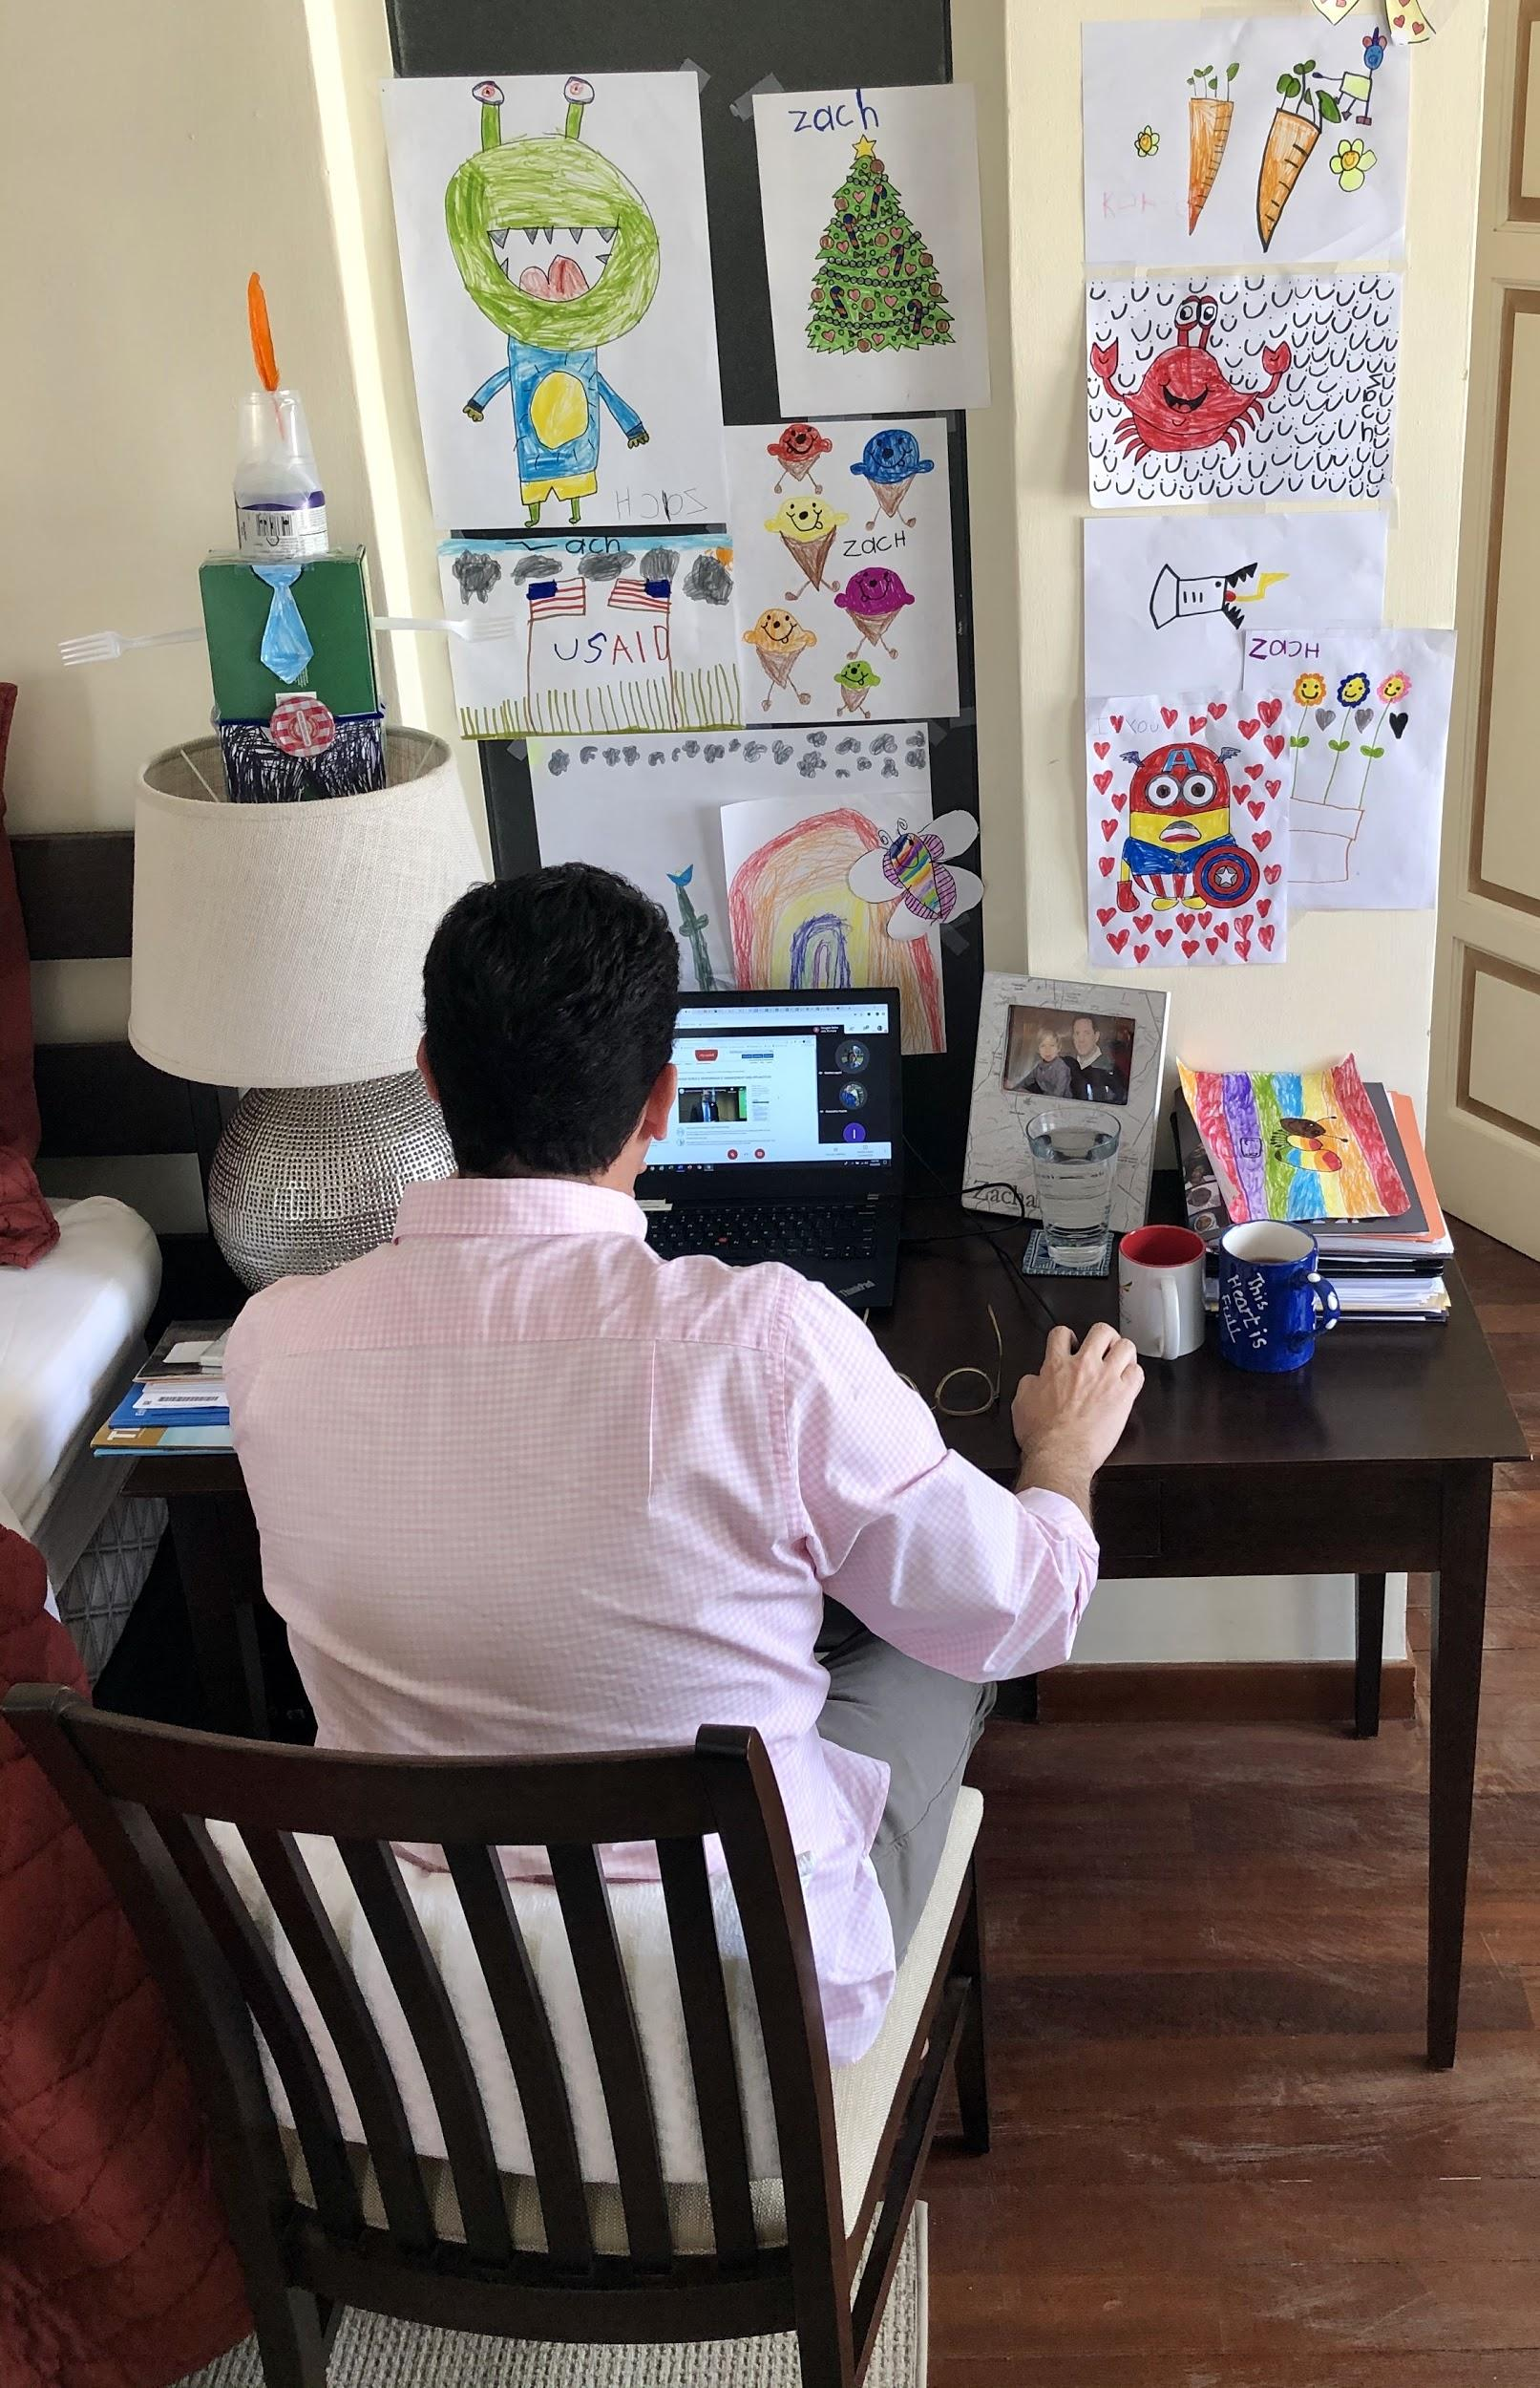
Welcome!

Slide 4
USG International Assistance Strategy for COVID-19
Coronavirus Preparedness and Response Supplemental Appropriations Act
$435 million Global Health Programs
$300 million International Disaster Assistance
$250 million Economic Support Fund
$264 million Operational Funds
USAID and Department of State in Partnership to Prioritize Needs, Review Proposals, and Allocate Resources
Where supplemental resources are unavailable, redirection or pivot of existing funding also on the table

Slide 5
USG International Action Plan for COVID-19
Goal:
USG will (1) Save lives by improving countries’ and international partners’ ability to respond to the pandemic; (2) Reduce secondary impacts of the pandemic; and (3) Promote U.S. leadership and share U.S. expertise for global benefit.
“SAFER” Approach:
Scale up community approaches to slow the spread of COVID-19
Address critical needs of health care facilities (public and private, including faith-based), health care workers, and patients
Find, investigate, and respond to COVID-19 cases
Employ strategies to address second order impacts
Ready plans for deployment of therapeutics and vaccines
Implementation: Whole-of-government, with USAID and State leading and coordinating efforts

Slide 6
USG International Assistance Strategy for COVID-19
USAID oversight, guidance, and coordination for COVID-19
COVID-19 Task Force
Coronavirus Response Management Team (RMT)
Technical Working Group
Funding Processes
Central Process for supplemental funding allocations
Approval of GH Redirection and Reprogramming Requests (pivots)
Information Gathering / Accountability for non-GH redirection

Slide 7
How USAID is Pivoting
Expedited Procedures Package (EPP)
  Blanket Authorization to Waive Competition to combat COVID-19
  Applies to contracts and grants
  Waives source nationality requirements , no 935 requirement
What does it mean ?
  Streamlined procurement actions to support COVID-19

Slide 8
How USAID is Responding in Ethiopia: Supplemental Funding
$3.35 million (GH) approved for:
  coordination, planning, monitoring;
  risk communication and community engagement;
  surveillance, rapid response teams, and case investigation;
  points of entry;
  national laboratories;
  infection prevention and control, case management
  supplies and commodities
$5 million available for OFDA: Review of concept notes underway:
  If partners are interested in support the COVID response in the areas of health, wash or protection they can submit a concept note directly to : addisofdaprogram@usaid.gov
Additional requests still pending

Slide 9
How USAID is Responding in Ethiopia: Redirections
USAID/Ethiopia redirected $17 million across multiple sectors
Office | Sector (as per GOE Multisectoral Preparedness and Response Plan) | Areas of Support
ALT | Agriculture (Livelihood protection) | Food security, livelihoods support, and WASH interventions in Highlands and Lowlands for vulnerable populations
 | Food (Food Assistance/Food Security) | COVID-19 safe food distributions, WASH facilities at Food Distribution Points, PPE (TBD based on guidance) for distribution staff, livelihood support, SBCC+
 | Protection (Peace and Security) | Support to the key messaging priorities of the Ministry of Peace's dedicated COVID-19 task force
 | Coordination (National Disaster and Risk Management Commission Support) | Technical assistance to NDRMC; supporting the Emergency Operations Center; support coordination between federal and regional level on COVID-19 response
Health | Health | IPC, Surveillance, Case Management, Risk Communication, Coordination
 | Protection (Persons with chronic health conditions) | Support People Living with HIV, Orphans and Vulnerable Children and Their Caregivers with food, hygiene product and education for adherence to HIV treatment
EYO | Education | Support for distance learning through Radio and TV supplemental educational instruction

Slide 10
How USAID is Helping our Implementing Partners
Support for ‘social distancing’ work environment
Additional telecom expenses like 3G
Transport subsidies for private transportation
Evacuation Costs
Covered all transportation for employees and dependents
Staffing Flexibilities
Offered additional options for employees that can’t telework
Communications and Information Sharing
USAID/Washington has created a dedicated COVID-19 website for IPs
All subject to budget availability

Slide 11
Monitoring Programs
Communicate often with your COR/AOR, especially difficulties in monitoring
Monitoring to the best of your ability - expand your monitoring toolbox if needed
Key informants
Phone-based surveys
Social media
Remote sensing
Share lessons learned with other partners - more information in the near future

Slide 12
Q&A - Part I (Submitted by Survey)
Long-term Impact and Strategy: How will COVID-19 impact USAID’s funding and strategy in the coming five years?
Results and Performance: How will USAID approach existing awards that are on pause or unable to achieve results as initially envisioned due to the pandemic?
Appeals and Asks: What should partners do if they receive a request for assistance from the GOE?
State of Emergency: What does USAID know at this point about the SOE? How is the US embassy engaging with the GOE to understand the impacts and/or advocate for exceptions?

Slide 13
Q&A - Part II (Google Hangout Chat Box)
Do we have details for what might be covered by Concept Notes to OFDA?
OFDA response: Health, WASH, Proteection
Is it possible to submit requests to provide food to FSWs so that they can ensure adherence to ARV treatment by ART clients?
How can beneficiaries be reached for monitoring if there is not good mobile coverage?
What will the longer-term impacts be on food security and nutrition? Will there be a need for increased supplementary feeding?
How soon does USAID think things will return to a state of normalcy?

Slide 14
Closing

